Slide 1

Department of CSE-AI & ML (CSM)
Team:BATCH1
21BQ1A42G3, 21BQ1A42E9,
21BQ1A42J0, 21BQ1A42J2
Project Title:
JOBQUEST: An interactive job and internship platform for technical education department
TEAM MEMBERS:
21BQ1A42G3 – Shaik Safileen
21BQ1A42E9 – P.V.S.S.Saikumar
21BQ1A42J0 – Alisetti Saiharsha
21BQ1A42J2 – Peeka Akash
Under the Guidance of:
(Project Guide) HOD-CSM,
Dr.S.L.V.V.D.Sarma Dr.K.Suresh Babu

Slide 2
Department of CSE-AI & ML (CSM)
Team:BATCH1
21BQ1A42G3, 21BQ1A42E9,
21BQ1A42J0, 21BQ1A42J2
Abstract:
The JOBQUEST System presents a comprehensive job portal system developed using the MERN stack, comprising modules for Admin, Jobseeker/Student, and Recruiter/Company. The Admin module allows the administrator to manage the portal effectively by viewing registered users, companies, and job postings, and logging out. The User module enables job seekers and students to register, log in, search for jobs based on their skills, receive recommendations, apply for jobs, participate in live or virtual exams, and track the status of their applications. The Recruiter module is designed for companies to register, log in, add job requirements, and create exams (MCQs) for applicants, and view user profiles and exam details. Recruiters can select or reject candidates based on exam performance and other criteria. The System aims to provide a seamless job application and recruitment experience, integrating key functionalities like job recommendations, online exams, and application status tracking, ensuring an efficient and user-friendly platform for both job seekers and recruiters.
The objective of this System is to design and develop a job portal that facilitates seamless interaction between job seekers, recruiters, and admins. The portal aims to enhance the recruitment process by providing features such as personalized job recommendations, online assessments, and application tracking, thereby improving efficiency and user experience for all stakeholders

Slide 3
Department of CSE-AI & ML (CSM)
Team:BATCH1
21BQ1A42G3, 21BQ1A42E9,
21BQ1A42J0, 21BQ1A42J2
The proposed system Job Quest enhances traditional job portals by integrating AI-driven resume scoring, skill-based job recommendations, and automated hiring processes. Unlike existing platforms that rely on keyword matching, Job Quest utilizes NLP and Machine Learning to provide accurate, bias-free, and personalized job matches. It also offers career insights, real-time job tracking, and an AI chatbot, making the recruitment process more efficient for both job seekers and employers.
Functional Requirements :
User Registration and Profile:
Allow users to create accounts using email.
Implement account verification processes using OTP.
Provide options for users to customize their profiles with personal information and dietary preferences.
Enable users to participate in recruitement process.
2. Admin Module:
Admin can log in securely to the system.
Admin can view and manage the list of registered users.
Admin can view and manage the list of registered companies.
Admin can view and monitor active job postings.
Admin has the ability to remove inappropriate content (job postings or user profiles).
Admin can monitor the integrity of data across the system (e.g., ensure correct user-job relationships).
Admin can generate reports on the number of registered users, companies, and jobs.

Slide 4
Department of CSE-AI & ML (CSM)
Team:BATCH1
21BQ1A42G3, 21BQ1A42E9,
21BQ1A42J0, 21BQ1A42J2
User Module (Jobseeker/Student):
Users can register by providing personal and professional details.
Users can log in with valid credentials. Users can create and edit their profiles (including adding qualifications, skills, and experience).
Users can search for jobs based on their skills, experience, and location preferences. Users receive skill-based job recommendations. Users can apply for job postings.
Users can participate in virtual exams (such as MCQs) as part of the recruitment process. Users can view the status of their job applications.
Users can track their progress in real time (application status, interview, and offer status).
4. Recruiter Module (Company):
Recruiters can register and log in with a company profile.
Recruiters can post new job openings and update job details.
Recruiters can create online assessments, such as MCQs, for applicants.
Recruiters can view user profiles (candidates who have applied).
Recruiters can evaluate the results of virtual exams.
Recruiters can accept or reject candidates based on exam results and profiles.
Recruiters can communicate with applicants regarding interview schedules or offer letters.

Slide 5
Department of CSE-AI & ML (CSM)
Team:BATCH1
21BQ1A42G3, 21BQ1A42E9
21BQ1A42J0, 21BQ1A42J2
5. Personalized Job/Internship Recommendations:
Analyze user data and generates personalized job/internship recommendations.
Offer suggestions based on the candidate’s skills and experience.

Slide 6
Department of CSE-AI & ML (CSM)
Team:BATCH1
21BQ1A42G3, 21BQ1A42E9
21BQ1A42J0, 21BQ1A42J2
Software Requirements:
1. UI Design: Figma
2. Programming Languages: TypeScript
3. Serverside Script : Express js
4. IDE/Workbench : VS Code
5. Database : Mongodb
6. Client Side : React js

Slide 7
Department of CSE-AI & ML (CSM)
Team:BATCH1
21BQ1A42G3, 21BQ1A42E9,
21BQ1A42J0, 21BQ1A42J2
Hardware Requirements:
Processor - I3/Intel Processor
RAM - 4GB (min)
Hard Disk - 160GB
Operating System : Windows 7/8/10

Slide 8
Department of CSE-AI & ML (CSM)
Team:BATCH1
21BQ1A42G3, 21BQ1A42E9,
21BQ1A42J0, 21BQ1A42J2
Results:
This JOBQUEST system, built using the MERN stack, provides a comprehensive and efficient platform for both job seekers and recruiters. By streamlining essential functionalities such as user registration, job searching, job application tracking, and recruitment management, the system offers a seamless experience for all users. Job seekers can easily search for and apply to positions that match their skills, participate in exams, and track the progress of their applications, while recruiters can efficiently manage job postings, create exams, and evaluate candidates. The Admin module ensures that the system remains well-maintained and organized. With its user-friendly interface and integration of important features like job recommendations, live exams, and application status updates, this job portal simplifies the recruitment process and enhances job-seeking efforts, making it a valuable tool for both companies and individuals seeking employment.

Slide 9
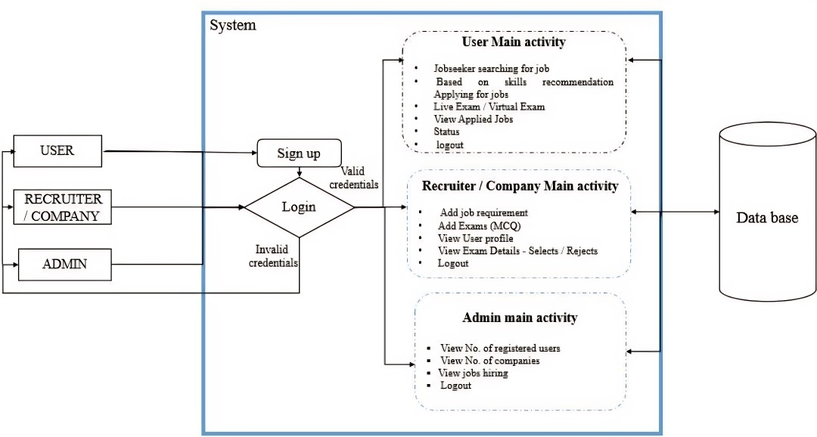
Department of CSE-AI & ML (CSM)
Team:BATCH1
21BQ1A42G3, 21BQ1A42E9,
21BQ1A42J0, 21BQ1A42J2
System Architecture

Slide 10
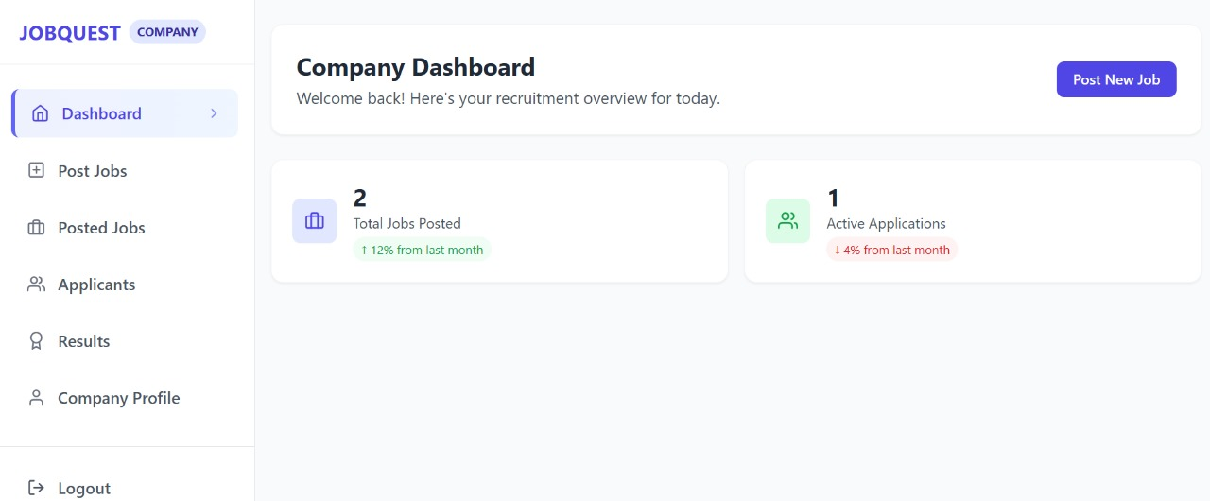
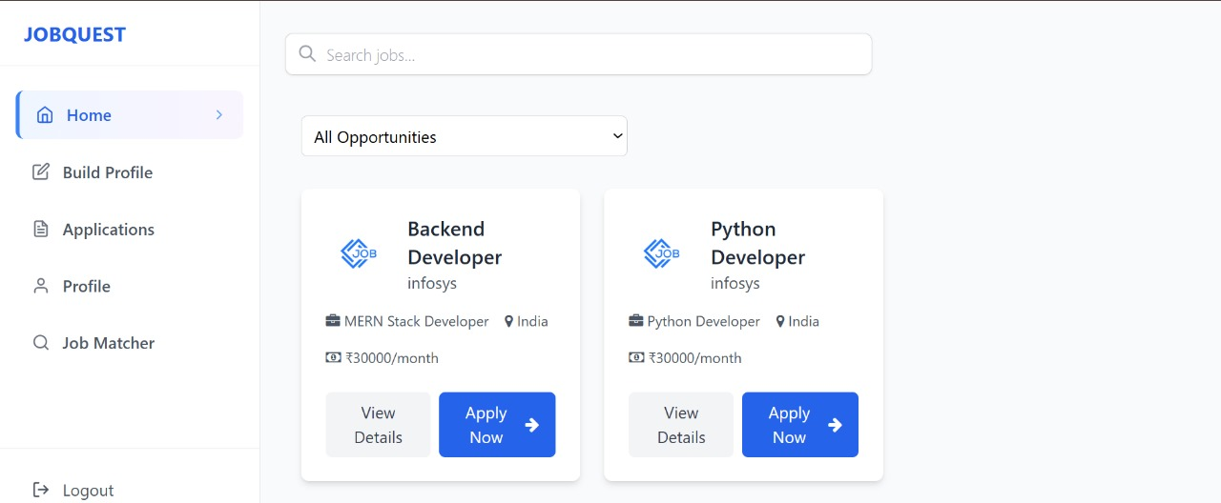
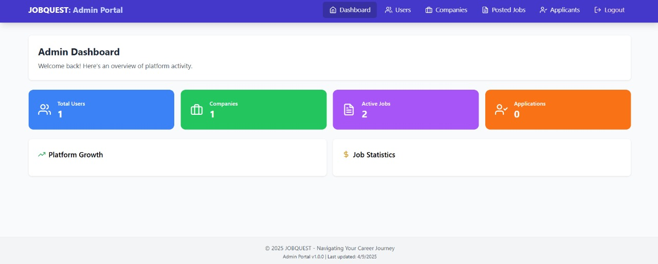
Department of CSE-AI & ML (CSM)
Team:BATCH1
21BQ1A42G3, 21BQ1A42E9,
21BQ1A42J0, 21BQ1A42J2
User, Admin, Recruiter Dashboards: This feature allows users, Admin and Recruiters to view and access their profiles once after their successful login with valid credentials.

Slide 11
Department of CSE-AI & ML (CSM)
Team:BATCH1
21BQ1A42G3, 21BQ1A42E9,
21BQ1A42J0, 21BQ1A42J2
User Home Page : This is the user page after successful login. The job details will be displayed.

Slide 12
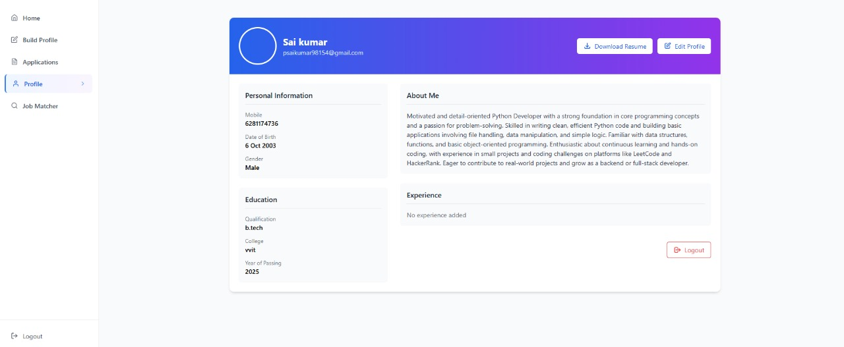
Department of CSE-AI & ML (CSM)
Team:BATCH1
21BQ1A42G3, 21BQ1A42E9,
21BQ1A42J0, 21BQ1A42J2
User Profile page: This is the user profile page here users can view their details.

Slide 13
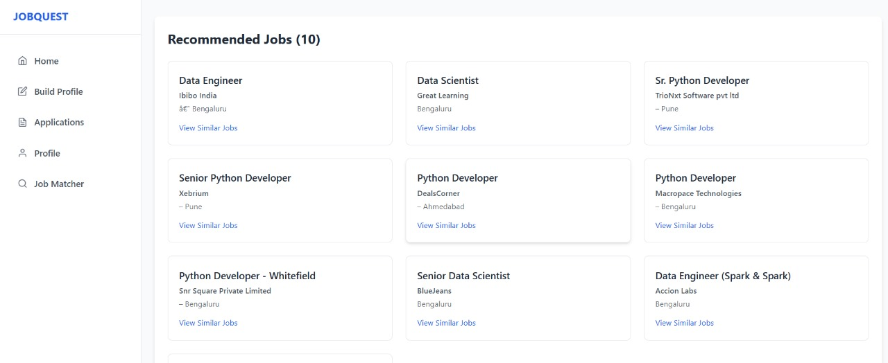
Department of CSE-AI & ML (CSM)
Team:BATCH1
21BQ1A42G3, 21BQ1A42E9,
21BQ1A42J0, 21BQ1A42J2
User Job Recommendation page: In this page the users will get their personalized recommendation based on their preferences.

Slide 14
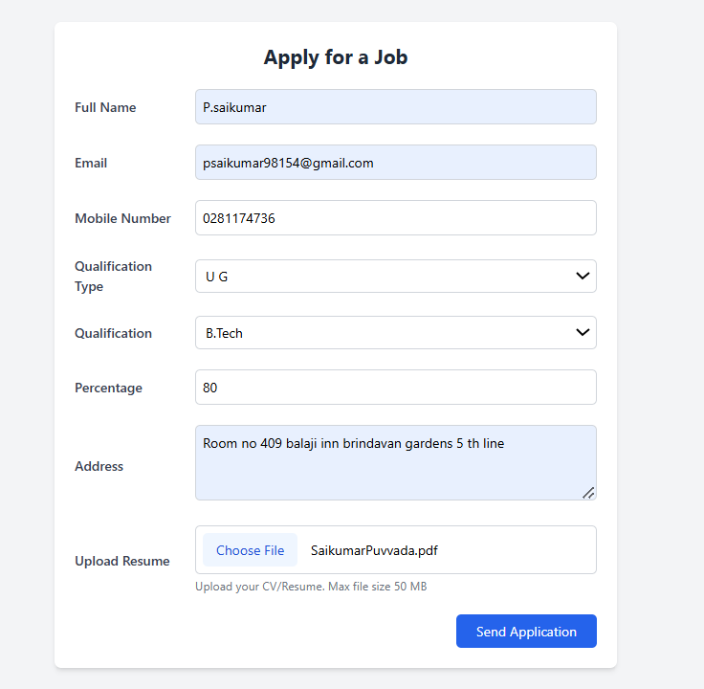
Department of CSE-AI & ML (CSM)
Team:BATCH1
21BQ1A42G3, 21BQ1A42E9,
21BQ1A42J0, 21BQ1A42J2
User Applying for Job/Internship page : In this page user can apply for a job.

Slide 15
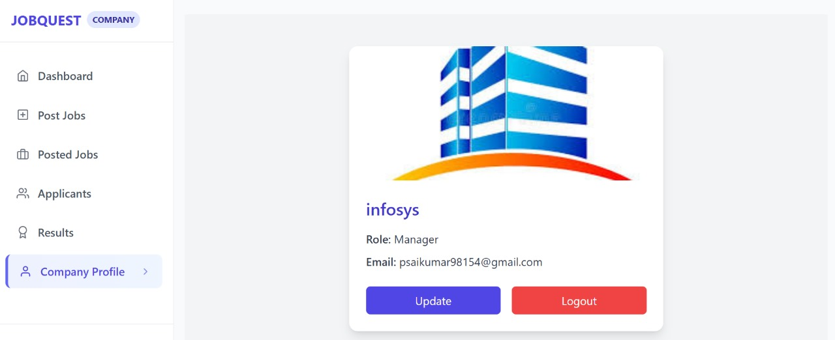
Department of CSE-AI & ML (CSM)
Team:BATCH1
21BQ1A42G3, 21BQ1A42E9,
21BQ1A42J0, 21BQ1A42J2
Employer/Company Profile page: This is the company profile page.

Slide 16
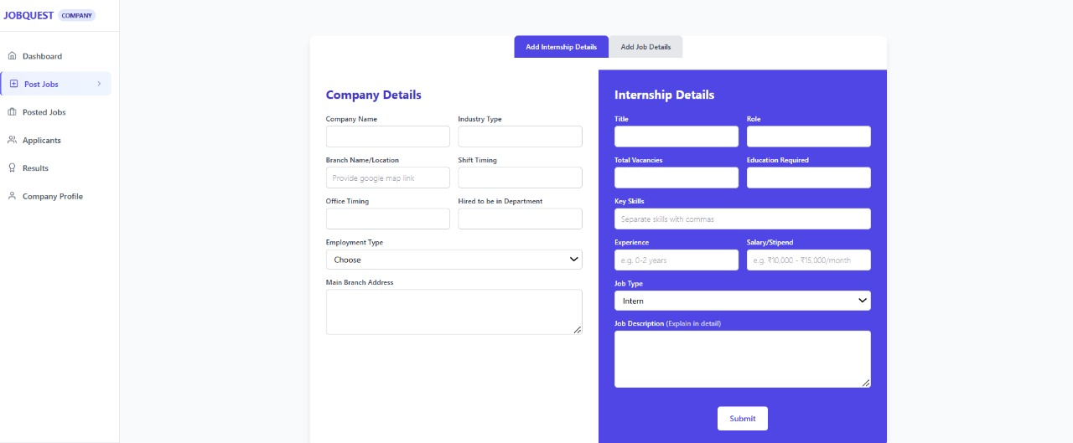
Department of CSE-AI & ML (CSM)
Team:BATCH1
21BQ1A42G3, 21BQ1A42E9,
21BQ1A42J0, 21BQ1A42J2
Employer/Company Job posting page: In this the employer will add the recruitement details of company details and role, location, salary etc.

Slide 17
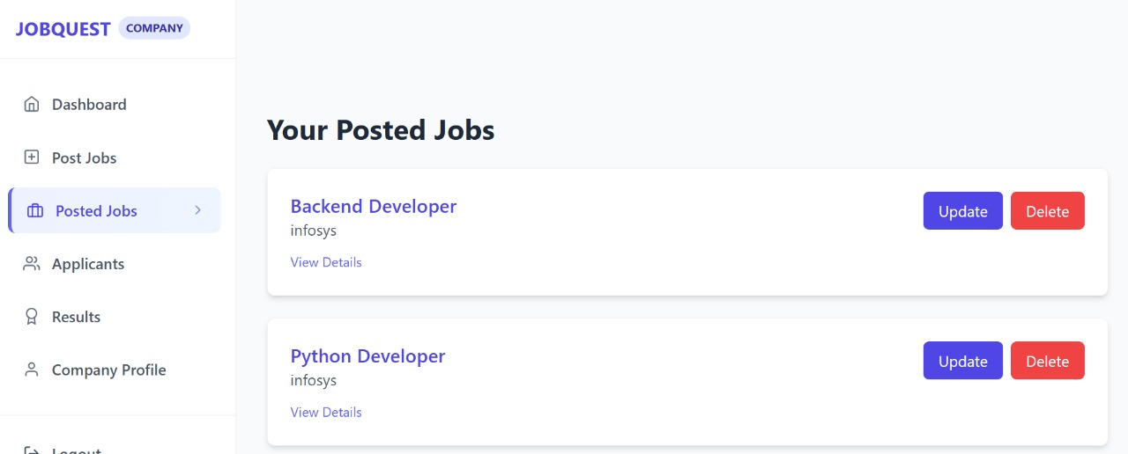
Department of CSE-AI & ML (CSM)
Team:BATCH1
21BQ1A42G3, 21BQ1A42E9,
21BQ1A42J0, 21BQ1A42J2
Employer/Company Posted Jobs page: In this page the employer/company can view the jobs posted by them and can update or delete them.

Slide 18
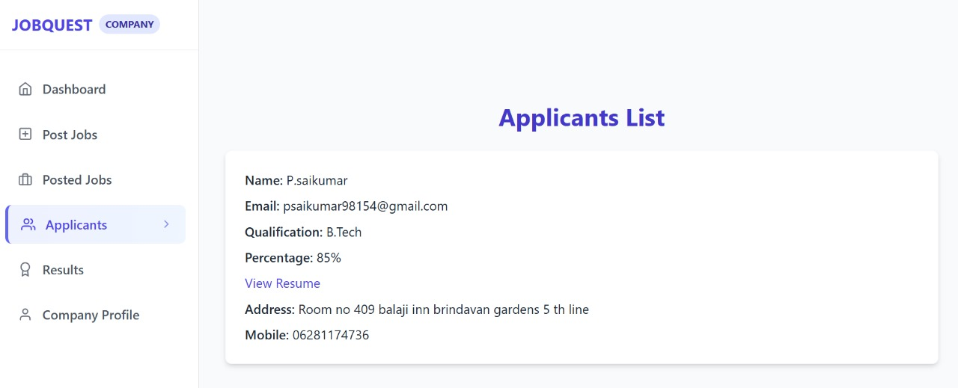
Department of CSE-AI & ML (CSM)
Team:BATCH1
21BQ1A42G3, 21BQ1A42E9,
21BQ1A42J0, 21BQ1A42J2
Employer/Company Application List page: In this page the Employer can view the applicants.

Slide 19
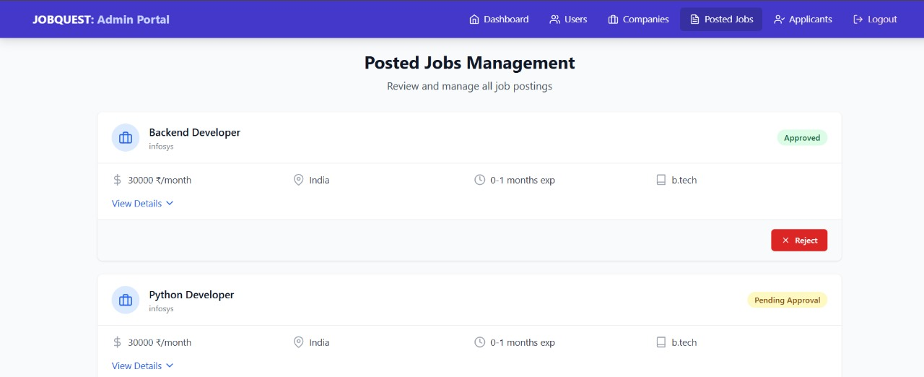
Department of CSE-AI & ML (CSM)
Team:BATCH1
21BQ1A42G3, 21BQ1A42E9,
21BQ1A42J0, 21BQ1A42J2
Admin Managing Posted Jobs page:In this page the admin can view and manage the posted jobs.

Slide 20
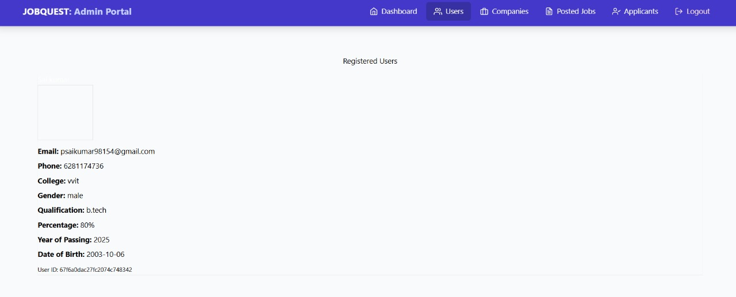
Department of CSE-AI & ML (CSM)
Team:BATCH1
21BQ1A42G3, 21BQ1A42E9,
21BQ1A42J0, 21BQ1A42J2
Admin viewing Registered Users page: In this page admin can view the registered users.

